Slide 1


Safety Excellence Group
Safety Excellence Group Analysis
VizStuds
Rohith Laisetty
Nikhita Mandava
Punya Ira Anand
Ramya Rajeswari

Slide 2



Problem Statement
To analyse past hand injuries in the manufacturing sector , and come up with preventive measures for health safety .
Goal
•Analyze historical workplace incident data
•Identify patterns and risk factors
• Suggest preventive measures for employee safety

Slide 3
OSHA- Occupational Safety and Health Administration
Workplace Safety- Sets standards for industries like manufacturing, construction, healthcare
Inspections & Citations- Conducts inspections and issues penalties for unsafe conditions
Recordkeeping- Requires employers to log injuries, illnesses, and fatalities
Reporting- Mandates reporting of severe injuries (hospitalization, amputation, death)
Training-Offers training and certification programs (OSHA 10, OSHA 30)
Support-Provides compliance assistance and resources for employers and workers

Slide 4
Methodology
Preprocessed and Filtered dataset to manufacturing sector + hand injuries
Used NLP techniques in column ‘Final Narrative’
Phrase extraction
Keyword analysis
Segmented by hospitalization, amputation.
Tools used
Python
Tableau
Excel

Slide 5
Data Preprocessing
Key columns
Final Narrative,
Part of Body Title,
SourceTitle,
EventTitle,
Amputation,
Hospitalized,
Geography
General Event

Slide 6

Top 3 Insights
Top phrases in the final narratives, such as 'index finger,' finger’ , ‘left index’, indicate that most injuries involve fingers and are often caused by machine-related contact, often leading to
amputation.
More than 75% of employees with amputations are not hospitalized, revealing a gap between injury severity and hospitalization, likely influenced by treatment inaccessibility and reporting practices.
Machine-related events like 'caught in equipment' are common causes of hand injuries.

Slide 7

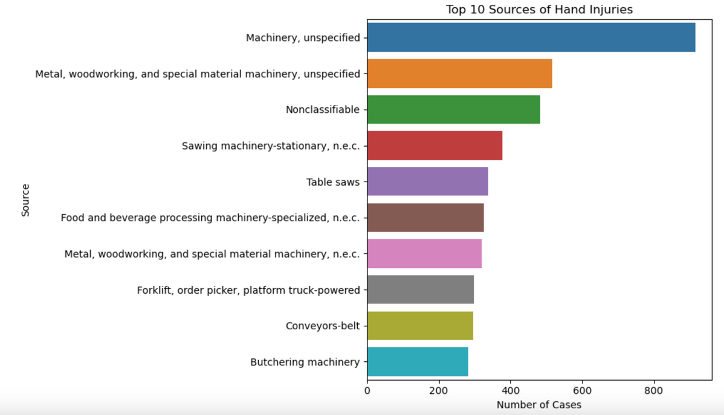
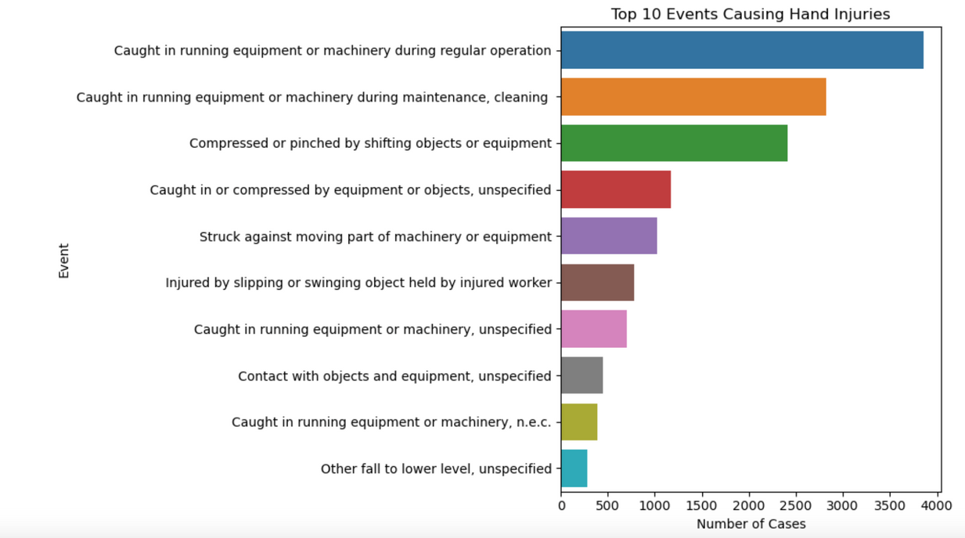
Explorative Data Analysis
Top Sources Causing Hand Injuries
Top Events Leading to Hand Injuries:
Notes:
Actionable Insights:
Implement mandatory PPE compliance (cut-resistant gloves)
Frequent safety training
Install safety shut-off mechanisms in high-risk machinery
Actionable Steps:
Use real-time sensors to detect unsafe machinery interactions
Implement job rotation policies to reduce fatigue
Provide automated handling tools

Slide 8
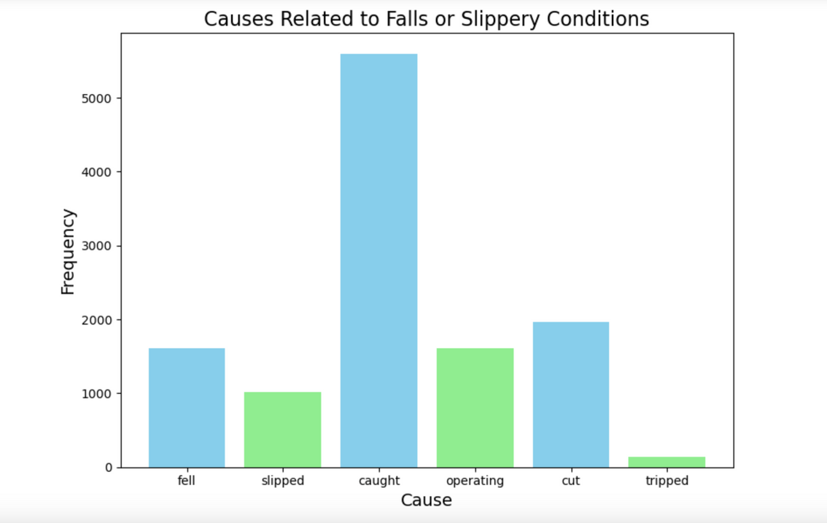
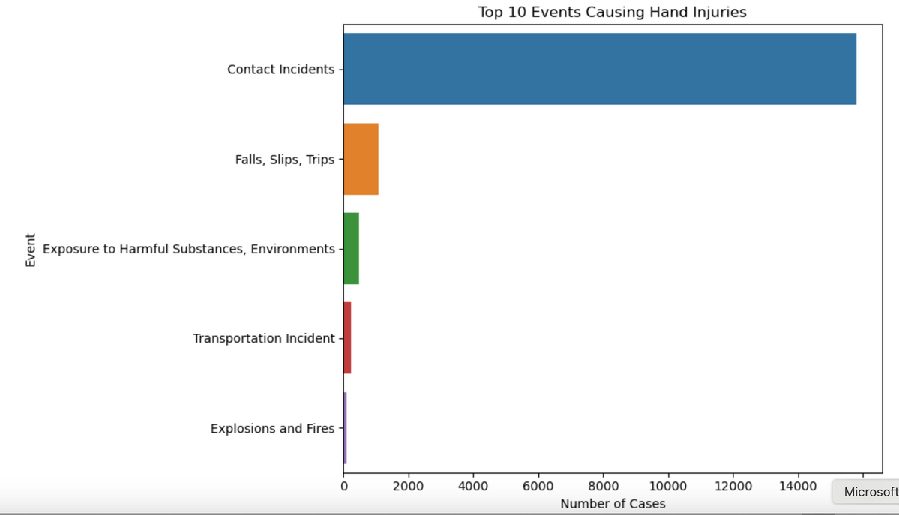
Explorative Data Analysis
Top cause related to slip and fall contitions
Top general events
Notes:
Used NLP to extract verbs and nous on Events vis a vis Final narrative to capture words that pertain to hand injury but might have not been primarily classified as one.

Slide 9
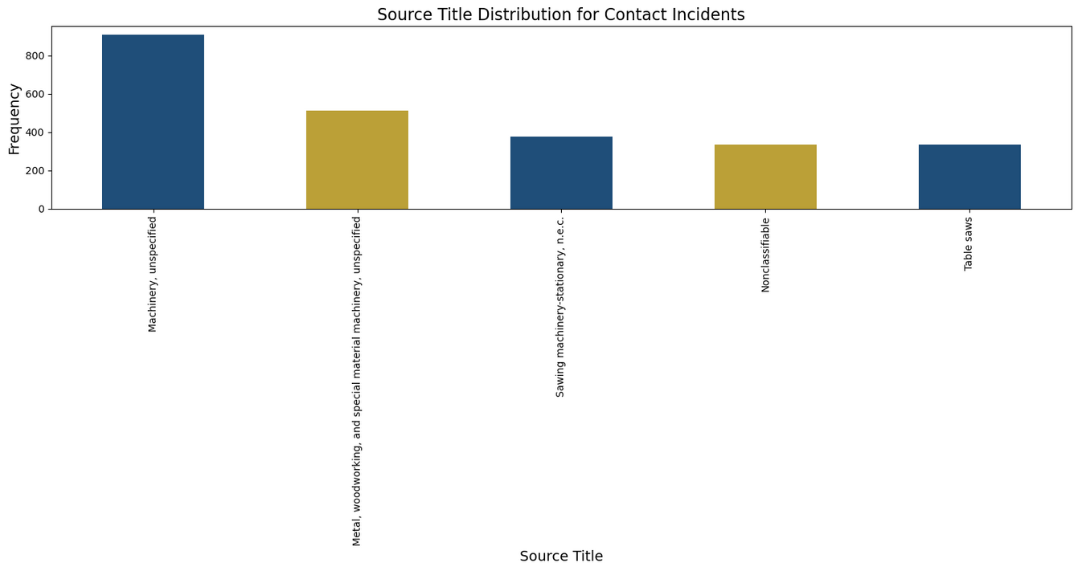
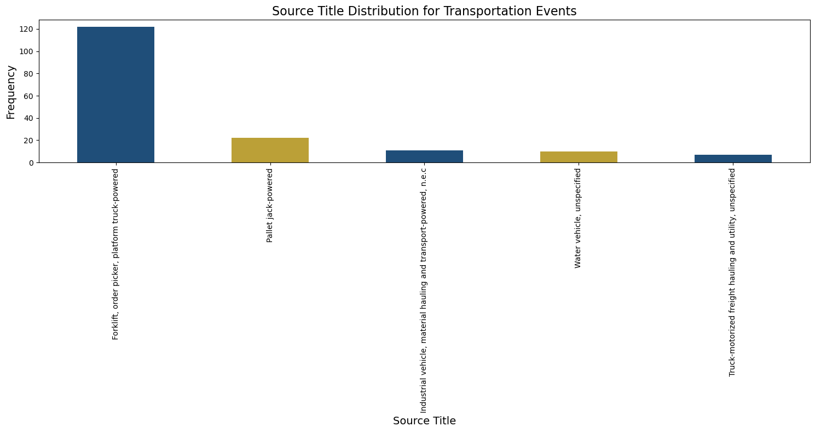
Explorative Data Analysis
Machinery
Metal wood working
Sawing machinery
Nonclassifiable
Table saws
Fork Lift
Pallet jack powered
Industrial Vehicle
Water Vehicle
Truck motorized freight
Notes:
Falls and Slips Are Preventable with Ergonomic Improvements
Insight: "Floor, n.e.c." and "Ladders, unspecified" are the primary sources of injuries in Falls, Slips, and Trips. These incidents are caused by unstable surfaces and unsafe ladder usage.
Actionable Recommendation: Improve workplace ergonomics by ensuring slip-resistant flooring and ladder safety standards. Introduce fall prevention systems like guardrails and harnesses to mitigate risks.

Slide 10
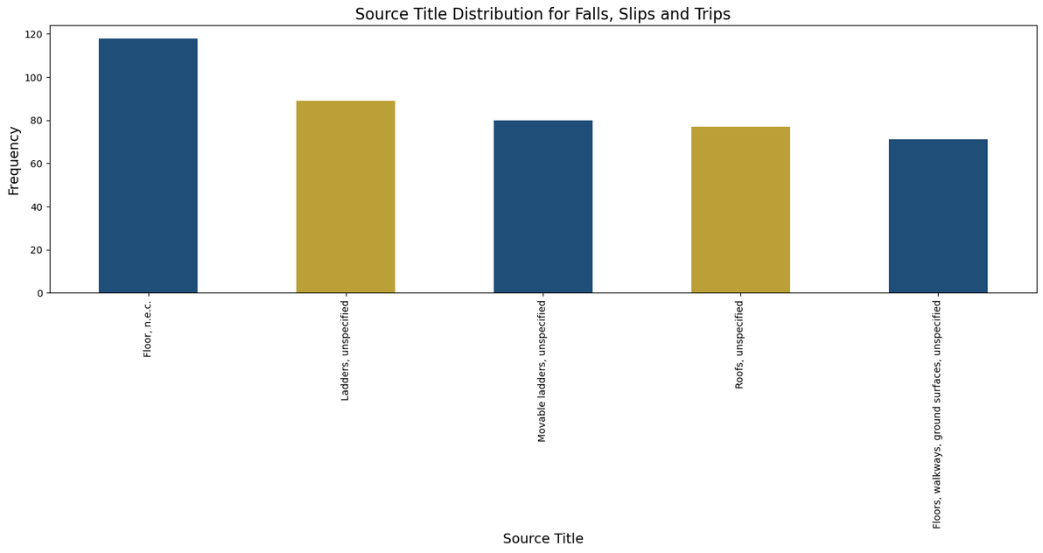
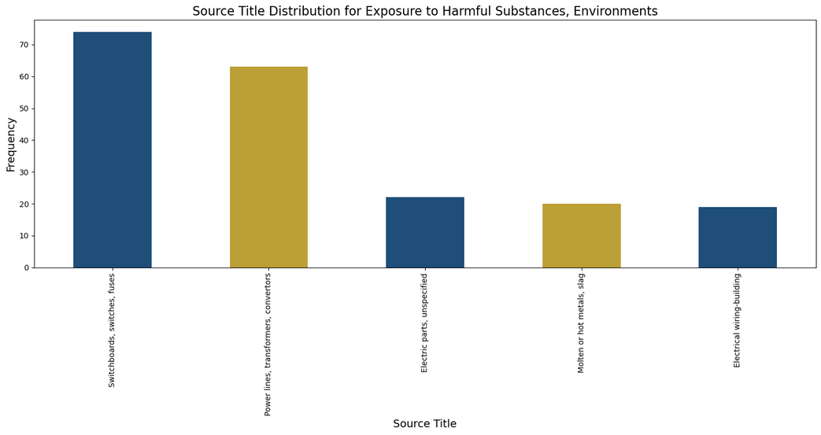
Explorative Data Analysis
Notes:
Insight: "Floor, n.e.c." and "Ladders, unspecified" are the primary sources of injuries in Falls, Slips, and Trips. These incidents are caused by unstable surfaces and unsafe ladder usage.
Actionable Recommendation: Improve workplace ergonomics by ensuring slip-resistant flooring and ladder safety standards. Introduce fall prevention systems like guardrails and harnesses to mitigate risks.
Electrical Hazards Require Stricter Safety Standards
Insight: Electrical hazards, such as incidents involving "Switchboards, switches, fuses" and "Power lines," are significant contributors to injuries under Exposure to Harmful Substances or Environments. Insufficient insulation and lack of protective gear are major factors.

Slide 11
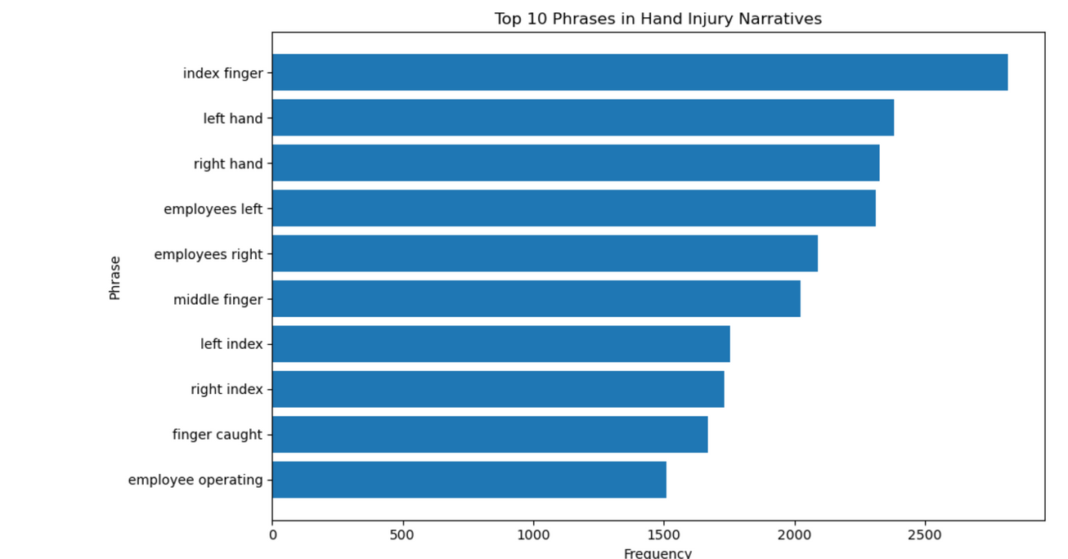
Explorative Data Analysis
Top ten phrases in Hand injuries:
Notes:
Actionable Steps:
Modify machine design (guardrails, emergency stop buttons)
Implement targeted safety measures

Slide 12
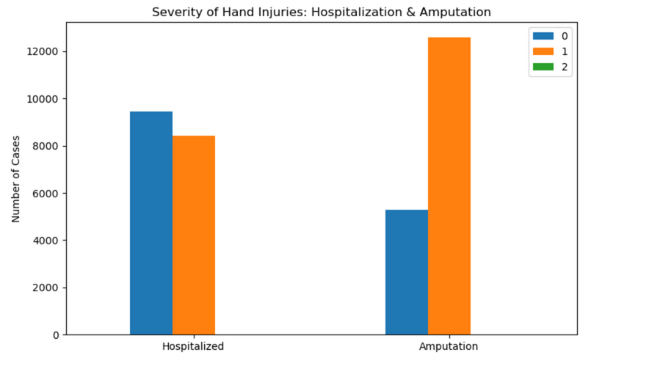
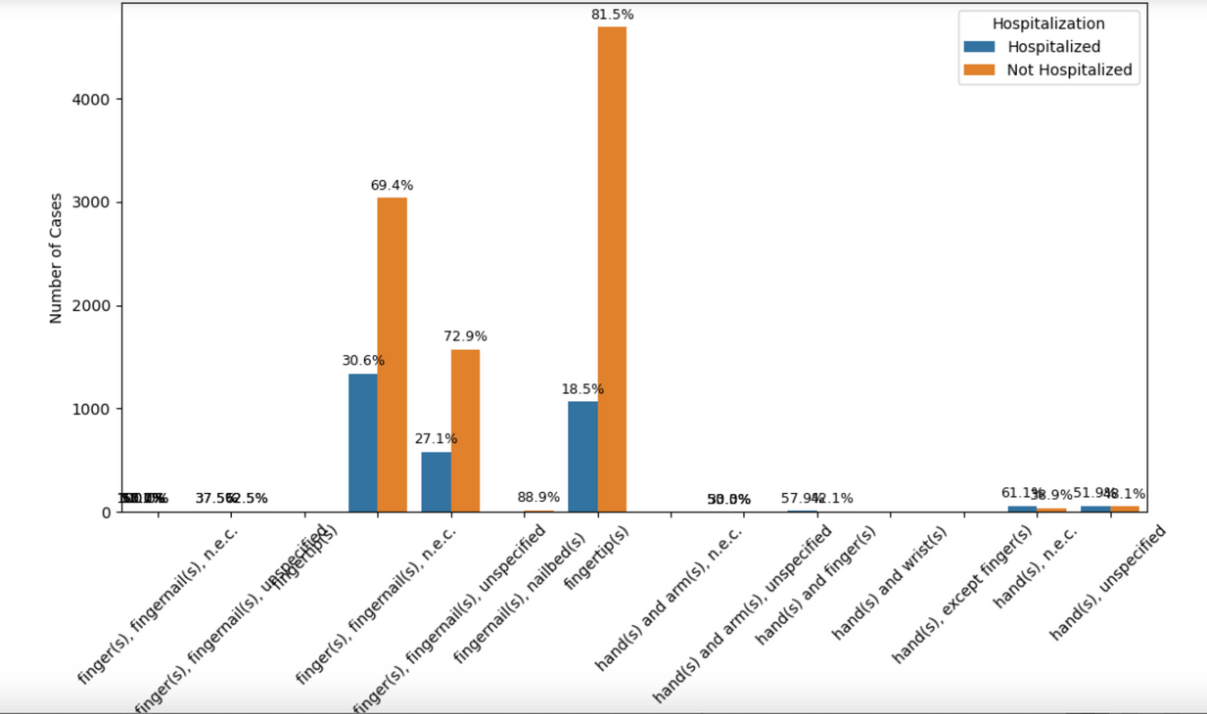
Explorative Data Analysis
Hospitalization vs Amputation Analysis:
Amputations are the most frequent but not always hospitalized - why?
•Fractures & cuts also common
Actionable Steps:
•Strengthen fall protection measures
•Introduce ergonomic work practices
•Ensure protective gloves in high-risk areas

Slide 13
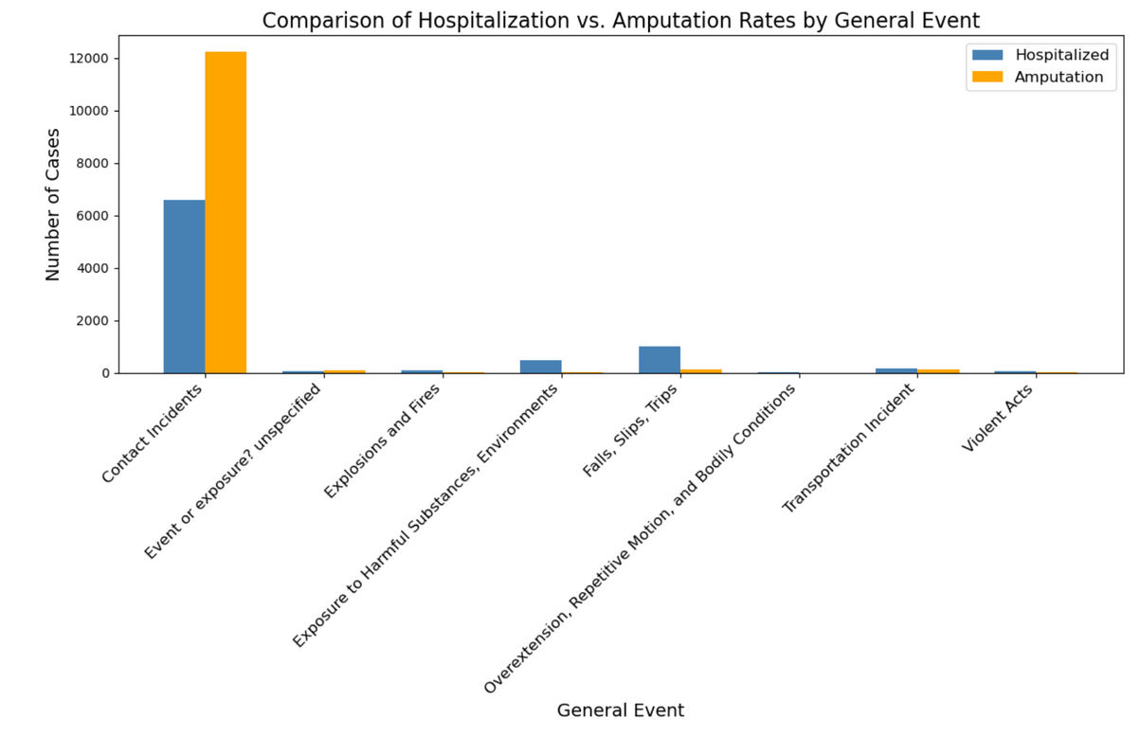
Explorative Data Analysis
Hospitalization vs Amputation Analysis across the General Events:

Slide 14

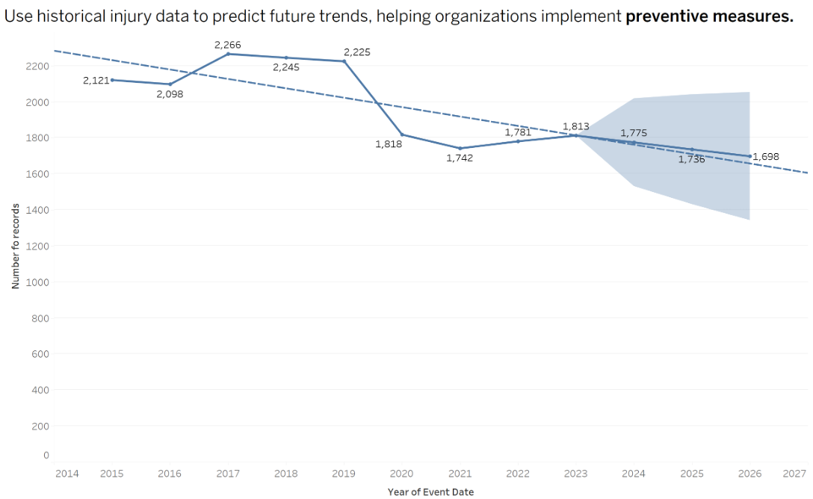
Future Predictions and Forecast based on the trend line
•Prediction: Continued decline in injuries
•Confidence Interval:
•Forecast suggests injuries range between ~1,698 to ~1,775 by 2027
•Wider bands indicate uncertainty in long-term predictions
•Actionable Steps:
•Improve forecasting models (adjust seasonality, refine data filtering)
•Compare pre-pandemic vs. post-pandemic trends

Slide 15
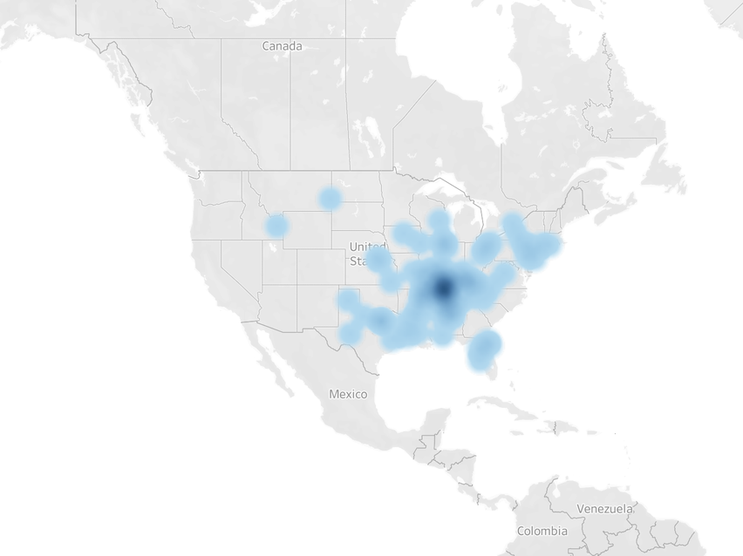
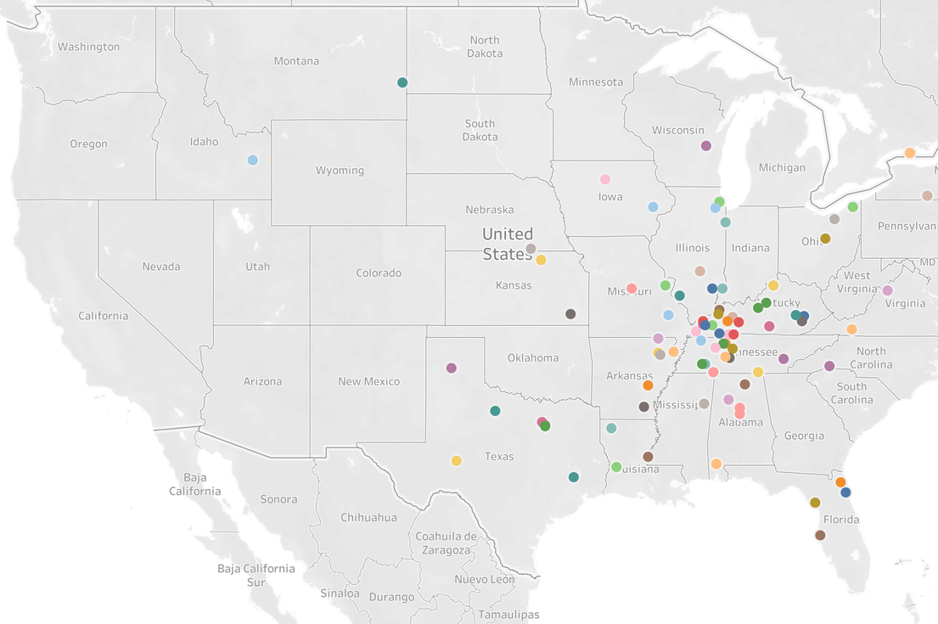
Injury distribution across the US
The darkest blue region is centered in the southeastern-central U.S. covering parts of:
Texas
Louisiana
Missouri
Mississippi / Alabama

Slide 16
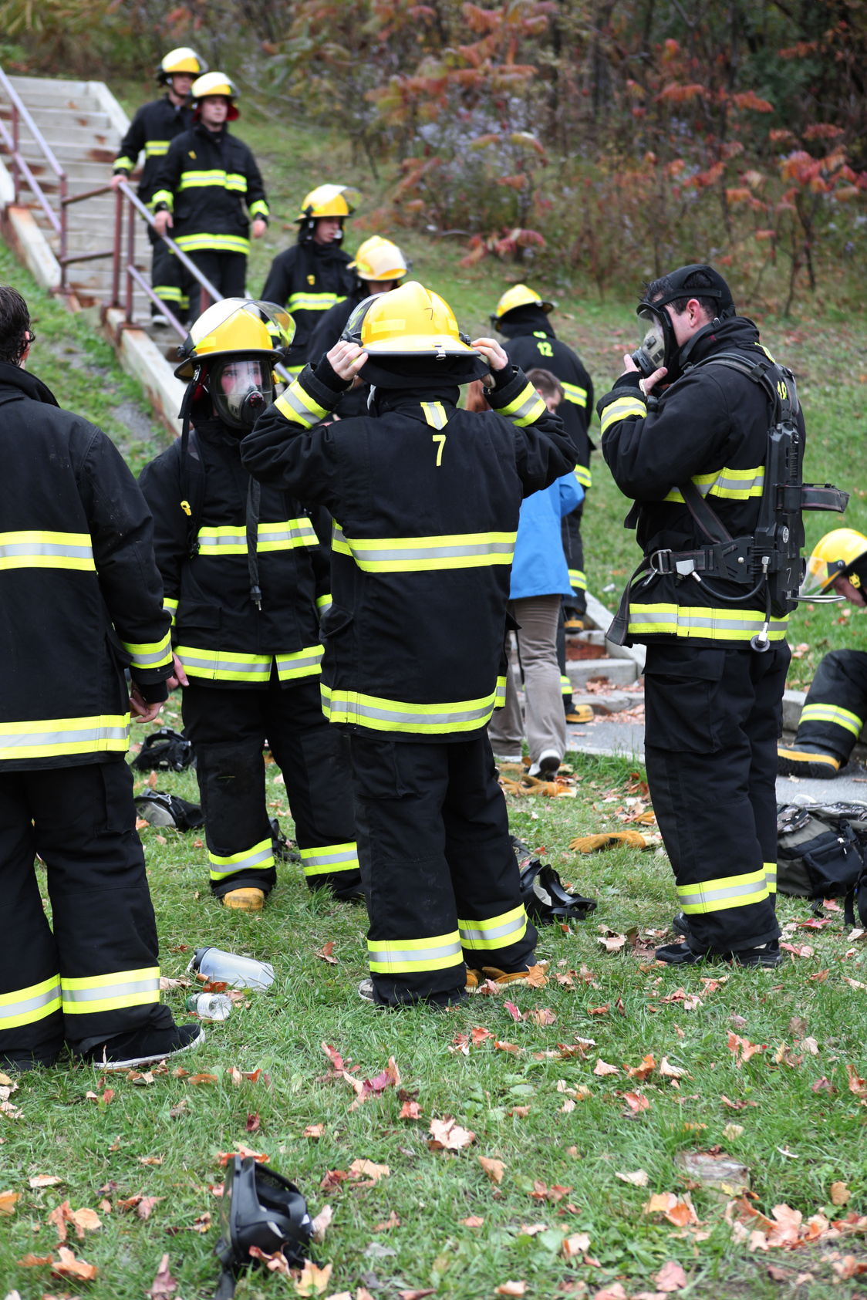
Top 3 Actionable Recommendations
1.Implement safer machine design and keeping in mind safety measures.
2.Ensure medical evaluations and reporting practices are done properly.
3.Need for better guarding and lockout/tagout practices.

Slide 17

Conclusion
Key Takeaways:
Finger injuries remain a major concern but show a declining trend over time.
Safety measures & automation contribute to risk reduction
More targeted interventions needed for further improvements
Underreporting or inconsistent injury classification may skew true severity and medical follow-up data.

Slide 18

Thank You

